Slide 1
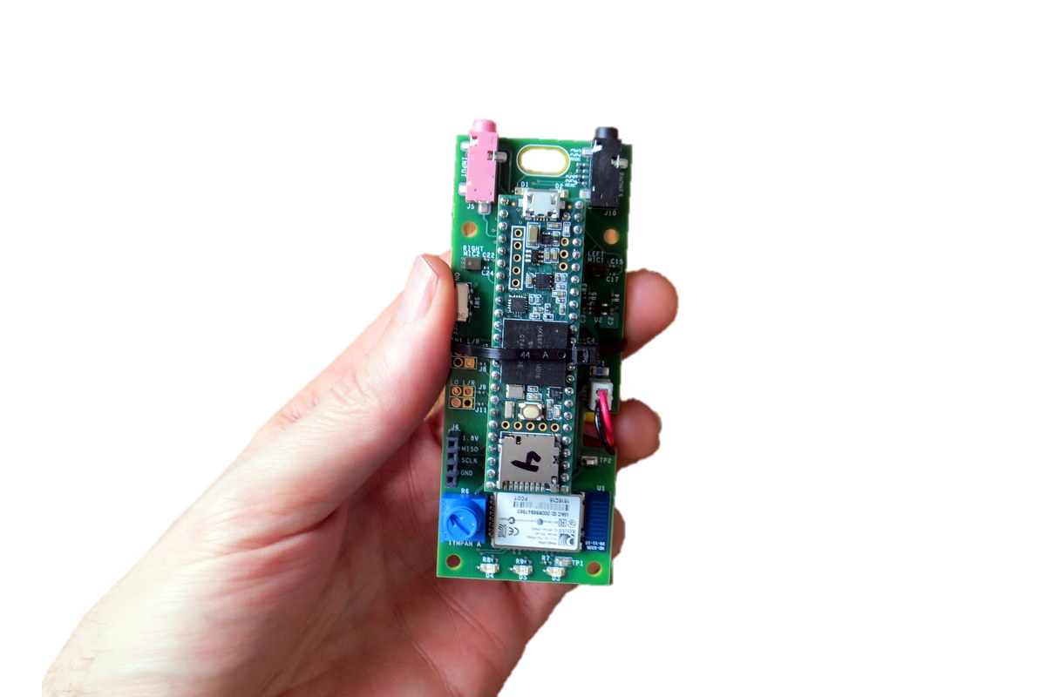
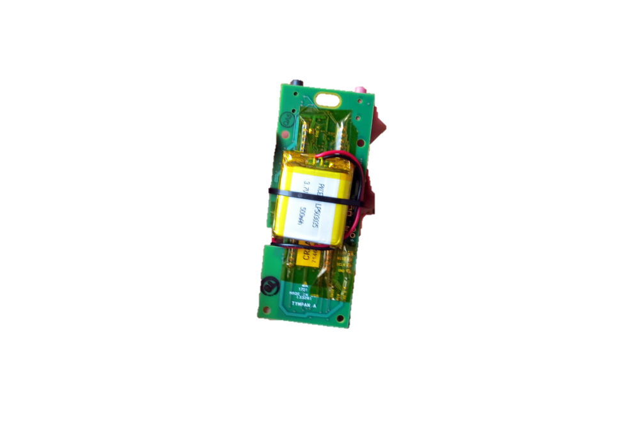
Tympan Rev A/C Hardware
USB to
Program/Recharge
Line-In / Mic Jack
Headphone Jack
On-Board Mic
On-Board Mic
Power
Switch
Li-Po Battery on Back
Bluetooth
Classic
User Pot
(Volume)
User
LEDs

Slide 2
Tympan Rev E, Goals
Goals:
Primary Goal: Smaller
Secondary Goals: Lower cost, more attractive, BLE, better microphones
Approach:
Integrate Teensy into Tympan Board, Swap BT Module, Shrink PCB Size, Possibly Change Mics
Unknowns: Which BLE Module, Which Mics

Slide 3
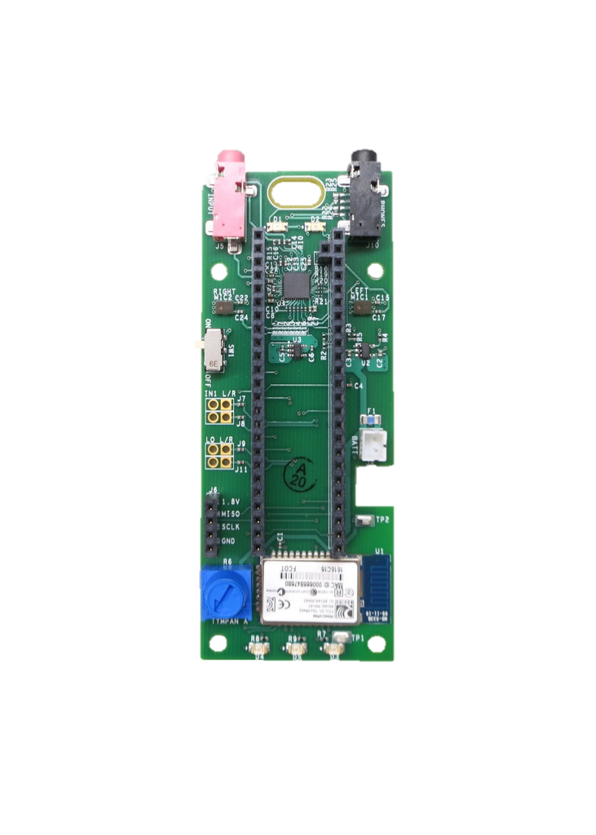
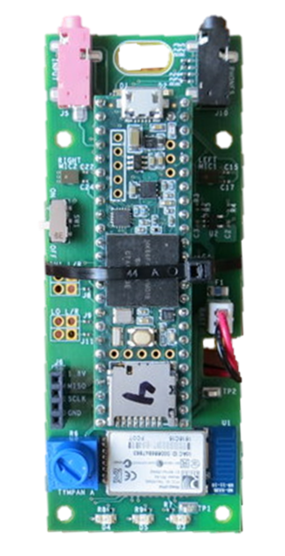
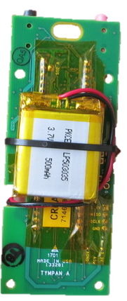
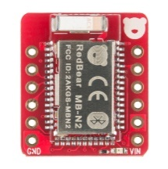
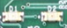
Tympan Rev E Ideas
Li-Ion Battery: (add extra room for wires)
Adafruit: 2000mA-hr: 2.4” x 1.4” x 0.3”
Adafruit: 500 mA-hr: 1.15 x 1.4 x 0.19”
Sparkfun: 400 mA-hr: 1.06 x 1.48 x 0.2”
Li-Ion Battery: (add extra room for wires)
Adafruit: 500 mA-hr: 29 x 36 x 4.76 mm
Sparkfun: 400 mA-hr: 26.5 x 36.9 x 5 mm
battery

Slide 4
Tympan Rev E Ideas
Li-Ion Battery: (add extra room for wires)
Adafruit: 500 mA-hr: 29 x 36 x 4.76 mm
Sparkfun: 400 mA-hr: 26.5 x 36.9 x 5 mm
Li-Ion Battery: (add extra room for wires)
Adafruit: 500 mA-hr: 1.15 x 1.4 x 0.19”
Sparkfun: 400 mA-hr: 1.06 x 1.48 x 0.2”
battery
Top
Bottom
Cover (Ick!)

Slide 5
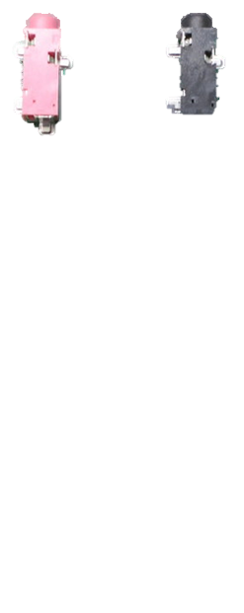
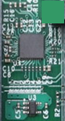
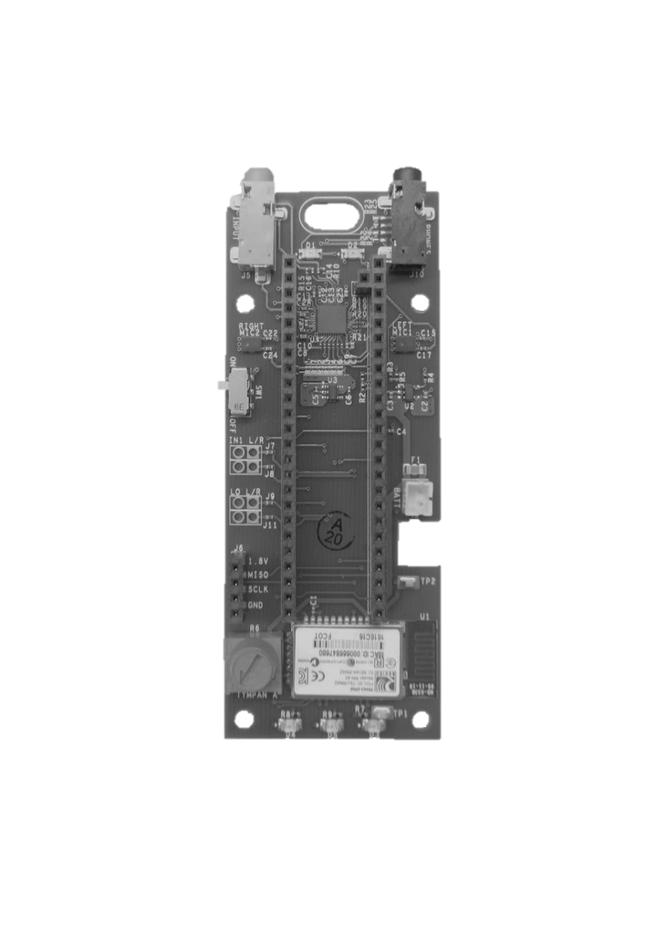
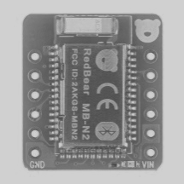
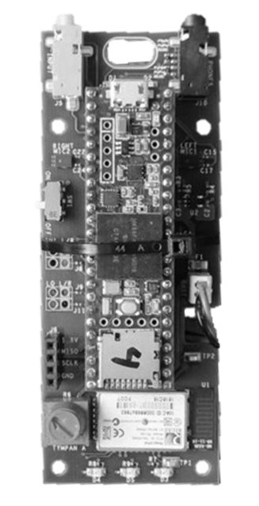
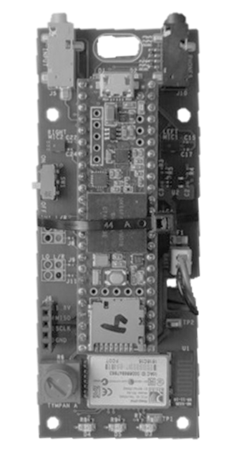
battery
battery
battery
Gray things are keepouts for stuff on the opposite site

Slide 6
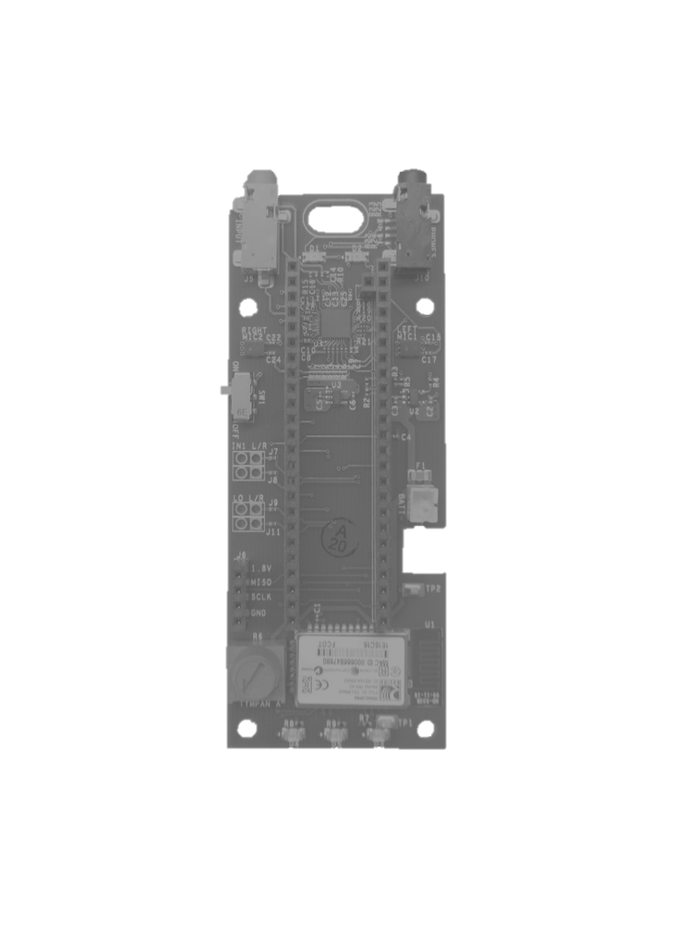
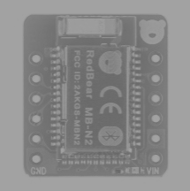
Best as of 1/18/2018, 4:35pm
Top
Bottom
Covered
Battery Sizes
1200mA
Battery
(0.2” thick)
500mA
Battery
500mA
Battery
(0.2” thick)
Gray things are keepouts for stuff on the opposite site

Slide 7
Comparison
Existing Tympan (PCB 3.81” x 1.51”)
WEA Concept
Jan 18, 2018
(PCB 2.87” x 1.55”)
1200mA-hr
(0.2” thick)
500mA-hr
Battery
(0.2” thick)
Stack of 3 Elements
(Battery+Typman+Teensy)
1.1” tall in enclosure.
Stack of 2 Elements
(Battery+Typman)
~0.75-0.8” in enclosure.
Battery
Sizes

Slide 8
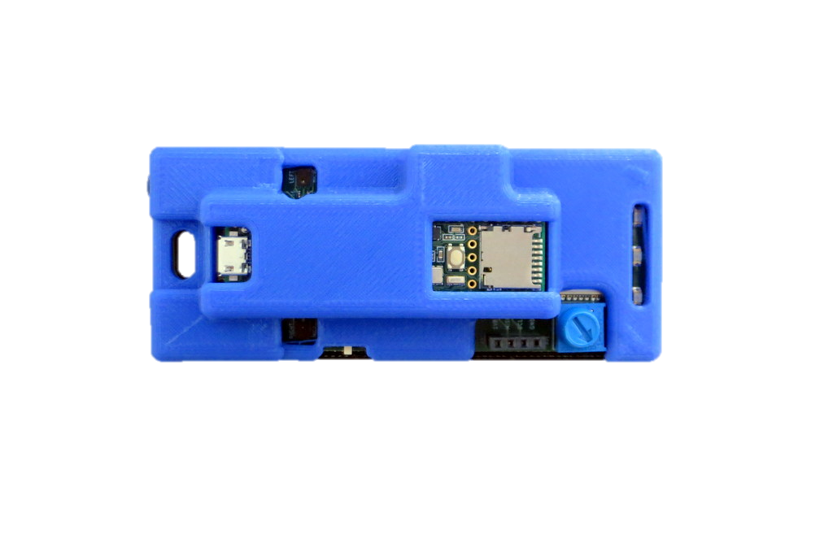
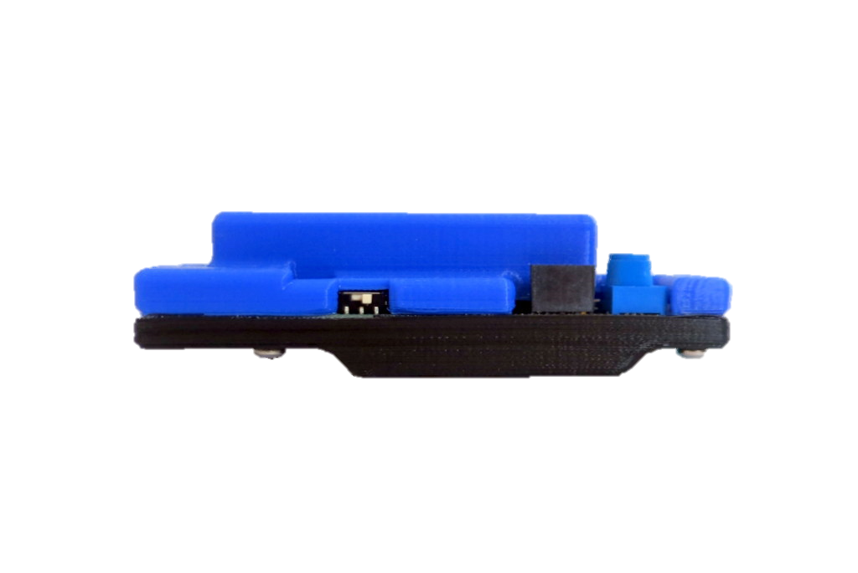
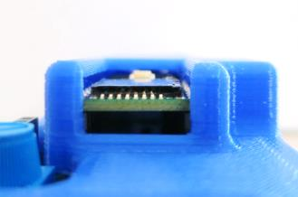
Smaller Tympan
Available Now
Smaller Concept
1.6”
1.75”
4”
3”
1.2”
0.75"
Same processor, same speed, same software
New Bluetooth unit (better connection to phone)
Potential for daughter card for better on-board mics

Slide 9
Making Daughter Cards

Slide 10
Daughter Cards?
3.3V
Fancy Microphone
(with Battery Bias)
Second AIC
(4-channel sound!)

Slide 12
batteries
Li-Ion Battery: (add extra room for wires)
Adafruit: 2000mA-hr: 2.4” x 1.4” x 0.3”
Adafruit: 1200mA-hr: 2.4” x 1.3” x 0.2”
Adafruit: 500 mA-hr: 1.15 x 1.4 x 0.19”
Sparkfun: 400 mA-hr: 1.06 x 1.48 x 0.2”
500
Battery
(0.2” thick)
1200
Battery
(0.2” thick)
2000
Battery
(0.3” thick)

Slide 13
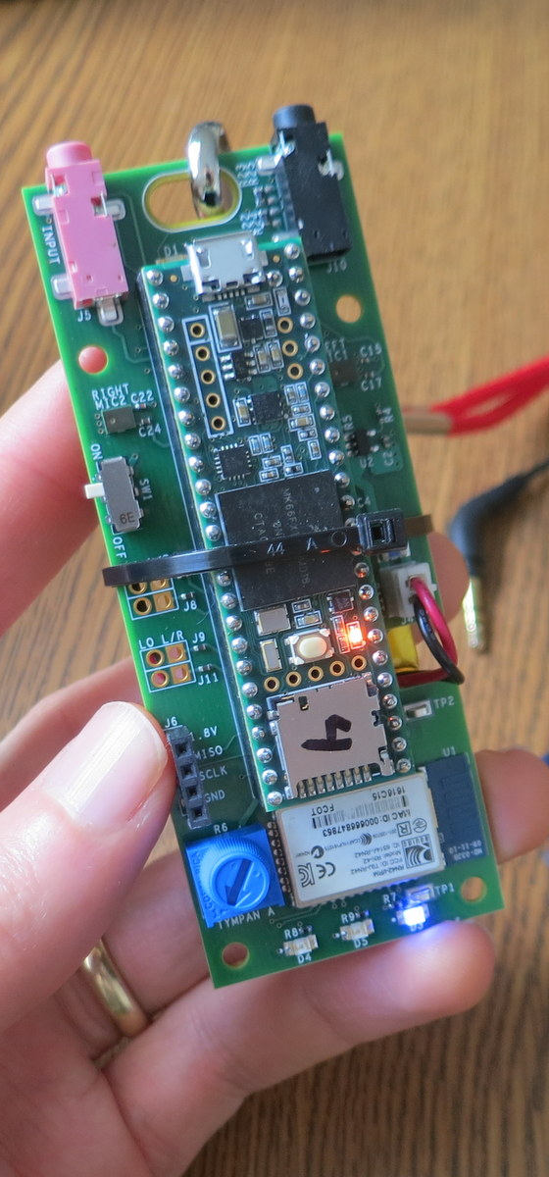
Hardware Specs
Processor
NXP MK66F (ARM Cortex M4F Core)
180 MHz with Floating-Point Unit
Analog-Digital
Texas Instruments TLV320AIC3106, stereo ADC and DAC
32/24/20/16-bit configurable (93 dB SNR)
Low-noise, software-controllable gain on inputs
Software-controllable microphone bias
Software-controllable headphone amplifier
Data Interfaces
USB Serial, USB Audio, USB HID
Bluetooth Classic
SD Card
Digital microphone port
Power
Draws about 100 mA @ 3.7V.
Power from USB or Li-Po Battery
On-board recharging from USB (with indicators)
Programming
Reprogram via USB. Program in C/C++.
Free, open-source toolchain
User Interaction
Potentiometer, LEDs, Bluetooth

